Slide 1
Text-to-3D
Group 4 Project Progress Presentation – 1
2024-09-05
Presented by:
Adrian Mauricio-Gonzalez, John Pacheco, Robinson Vasquez, Lam Nguyen, Suranadi Dodampagamage

Slide 2
Progress Summary
The objective over the past two weeks has been to gain an understanding of the text-to-3D domain
This was accomplished through the following:
Reading relevant research papers
Identifying related datasets
Implementing open-source frameworks
Ideally, by next week, the goals of our project can be more focused and refined based on what we have learned

Slide 3
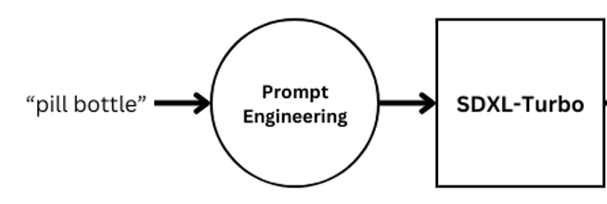
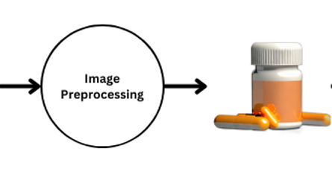
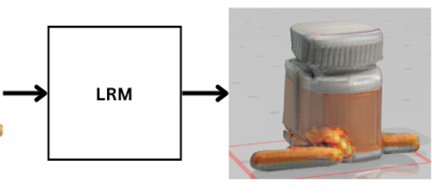
Contribution Summary - Adrian Mauricio Gonzalez
I identified and summarized numerous open-source frameworks related to 3D object generation
One of the key frameworks, Large Reconstruction Model (LRM), utilizes DINO and a triplane decoder to generate a 3D image from a 2D image
To apply this, I created a makeshift pipeline that integrates SDXL-Turbo with LRM

Slide 4

Contribution Summary - John Pacheco
MVDream - Multiview Diffusion for 3D Generation - https://arxiv.org/abs/2308.16512
Stable Diffusion v2.1 base model used
More detailed output by comparison
Joint training of text-2d and multi-view images of 3D assets
Limitations:
Struggles with generating realistic models
Only generates 256x256 images from SD
Additional Datasets
ModelNet - https://modelnet.cs.princeton.edu
ShapeNet - https://www.shapenet.org/
scanObjectNN - https://hkust-vgd.github.io/scanobjectnn/
PartNet - https://cs.stanford.edu/~kaichun/partnet/
Laion-3d - https://github.com/LAION-AI/laion-3d

Slide 5
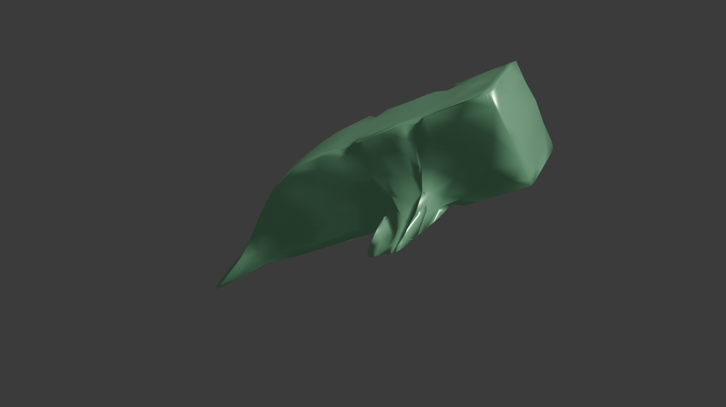
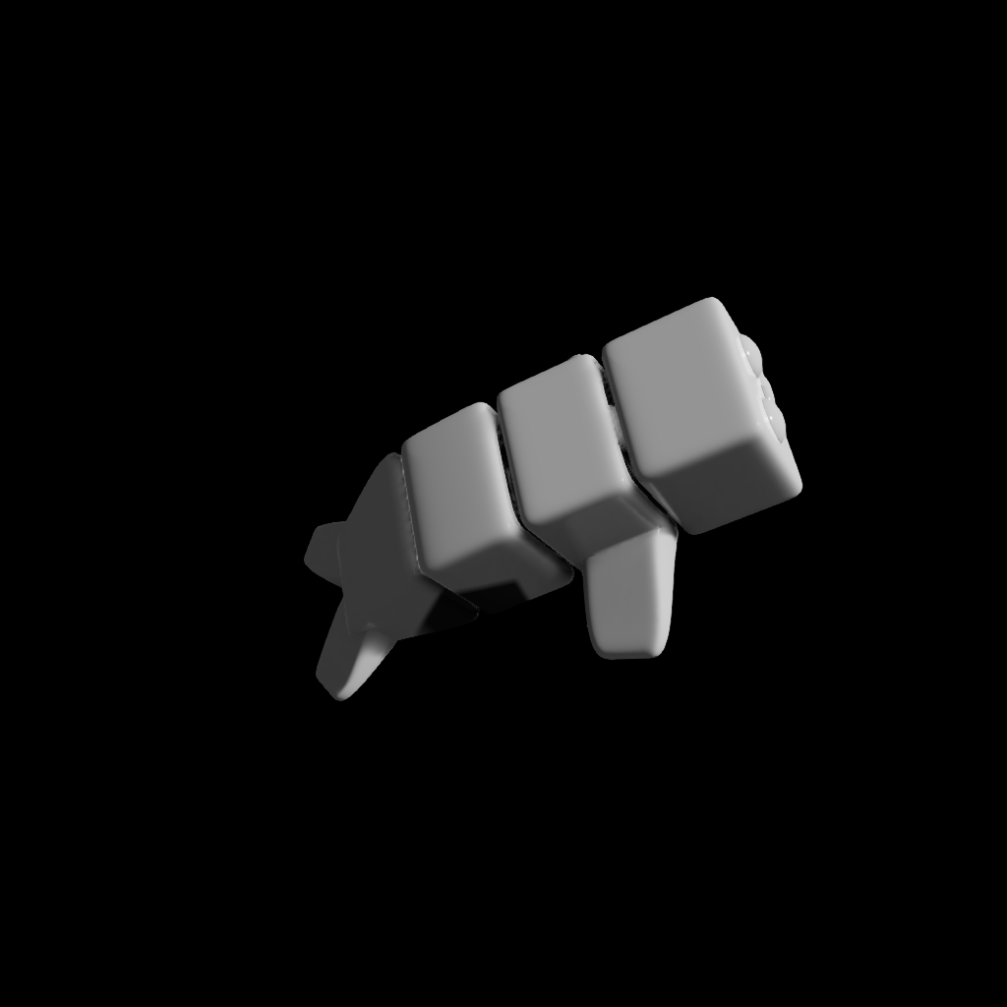


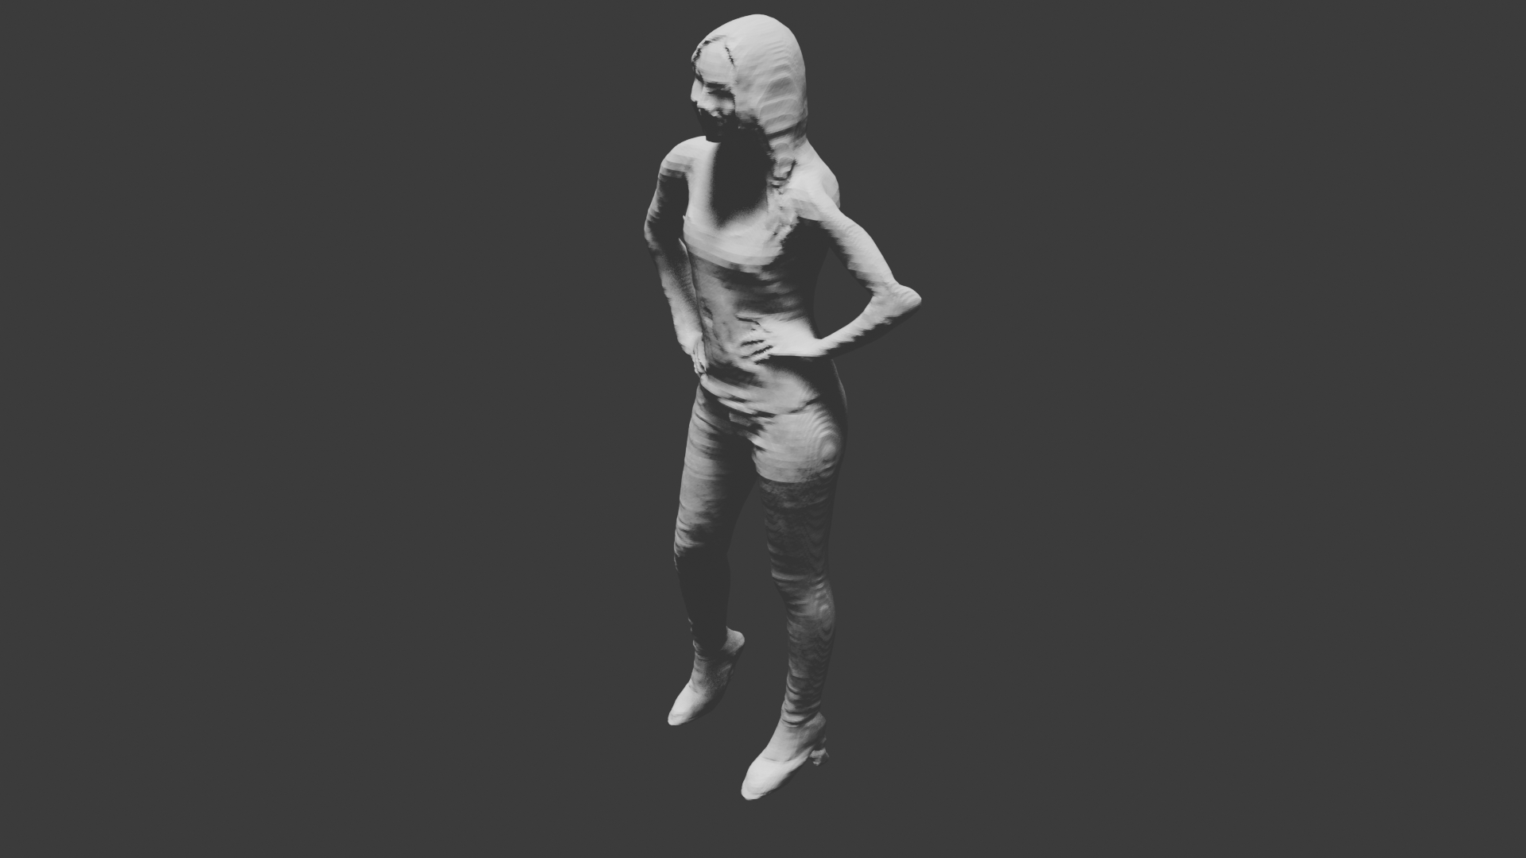
Contribution Summary- Lam Nguyen
Research Results (Text to 2D Image):
Use Stable Diffusion to generate same image at different angles
Source: https://www.youtube.com/watch?v=A-rke9y596A
Research Results (2D Image to 3D Model) :
Nvidia Kaolin: Input (RGB Image, Image metadata, Semantic Segmentation Data) -> 3D Model . The downside is that it requires alot of images and 3 types of 2D image data. How to get this data? The upside is that it doesn’t require very powerful hardware.
PifuHD: Input( Single Human Image, Semantic Segmentation Data) -> 3D Model. The downside is that it only works on images of people. The upside is that it can be used on consumer grade hardware and produces very usable models.
Nvidia Kaolin
PifuHD

Slide 6

Contribution Summary - Robinson Vasquez
Research Papers
Neural Radiance Fields
Using Tri-encoder to align images, 3d images and text
3D encoders
Model Execution
OpenAi Shap-E
Dataset Analysis
Objaverse-XL - Consists of >10 million 3D objects
Comes with an API
Consists of Url where object file is located, source, file type and sha-256 code
Trouble Rendering using their API
Gives Camera Matrix

Slide 7
Contribution Summary - Suranadi
Tried different models that generate 3D images
Shap-E
Creates 3D objects conditioned on text or images.
Limitation : does not create highly detailed or high resolution images
Dream Fusion
Uses a diffusion model to create text to 2D images
Combines it with NeRF model to generate 3D images
Model setup - In progress
Several ways of 3D representations (Point clouds, Voxel, Mesh, NeRF etc.)
NeRF

Slide 8
Signatures
Adrian Mauricio-Gonzalez
John Pacheco
Suranadi Dodampagamage
Robinson Vasquez
Lam Nguyen

